Slide 1

Welcome to Sukkur IBA University- Kandhkot Campus

Slide 2
Introduction to ICT
Welcome
Class: THP/Foundation 2021
Sukkur IBA University, Kandhkot Campus
Week - 01
Lecture - 01
Your Facilitator, Muzamil Hussain

Slide 3
About Me
Qualification: BS & MS in Computer Science
Designation: Lecturer in Computer Science Department at SIBAU – Kandhkot Campus
Email: muzamilhussain.kdk@iba-suk.edu.pk
Office Location: Faculty Room # 2
Counselling Hours: Anytime on Monday to Friday. If I am not available just leave message before coming.

Slide 4
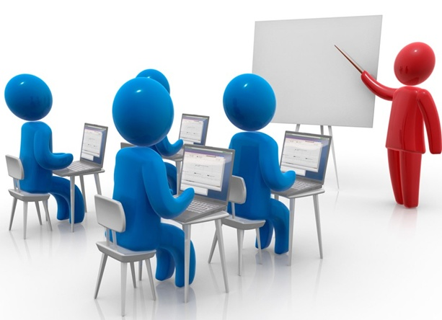
About Course

Slide 5
Course Objectives
This is very fundamental and very basic course of ICT which introduces ICT to students and enables them to learn proper use of ICT and its enablers like Computer, Smart Phone, Communications Networks and the Internet.

Slide 6
Learning Outcomes
To make students familiar with the world of ICT.
To make students familiar with computer, components of a computer, concept of memory, processing of data, software, computer networks and the Internet.
To learn practical use a computer.
To learn practical use of email, social networking websites and search engines.
To learn practical use of applications software for preparation of various types of document.
To learn practical use of applications software for preparation workbooks.
To learn practical use of applications software for preparation presentations To make students familiar with threats of cyber world and guidelines for protection.

Slide 7
Recommended Books
Discovering Computers Book by Gary B. Shelly 2011, 2016
Understanding Computers by Morley 15th Ed
MS Office 2013 Manual

Slide 8
Grading Policy
Theory | Marks
Mid – I | 20 %
Mid – II | 20 %
Quiz | 10 %
Assignment | 10 %
Final | 40 %
Total | 100 %

Slide 9
Important Points
Respect to other’s opinion in class
No cross-talk during class
Use of mobile phones in class is strictly prohibited without permission.
If you have any question raise your hand first and then ask question

Slide 10


Slide 11
What is ICT?
Information and Communication Technology.
Information and Communication Technologies (ICTs) is a broader term for Information Technology (IT), which refers to all communication technologies, including the internet, wireless networks, cell phones, computers, software, middleware, video-conferencing, social networking, and other media applications and services enabling users to access, retrieve, store, transmit, and manipulate information in a digital form.

Slide 12
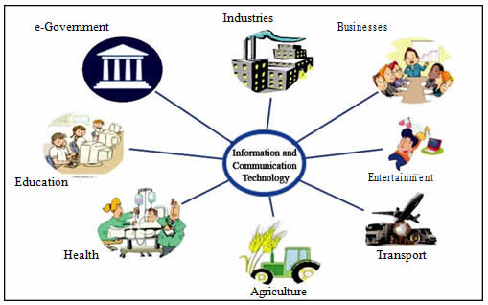
Where is ICT?
It is everywhere.

Slide 13
Group Activity # 01
What variety of tasks computers used for?
In the Homes?
In Education?
On the Jobs?
On the Go?
In Government?
In Health?
In Transport?
In Business?
In Industry?
In Agriculture?

Slide 14
Computers in Home
Computers used for a variety of tasks:
Looking up information and news
Exchanging e-mail
Shopping and paying bills
Watching TV and videos
Downloading music and movies
Organizing digital photographs
Playing games
Telecommuting

Slide 15
Computers in the Home
Convergence
The computer has become the central part of home entertainment
Dual-mode mobile phones
Wireless networking
Computers can be used in nearly any location
Smart appliances
Traditional appliances with built-in computer or communication technology
Smart homes
Household tasks are monitored and controlled by a main computer in the house

Slide 16
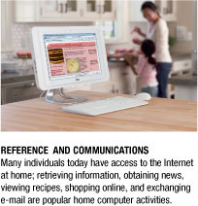
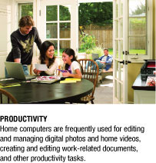
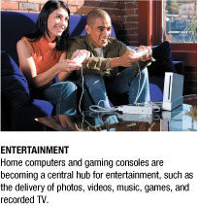
Computers in the Home

Slide 17
Computers in Education
Many students today have access to computers either in a classroom or a computer lab
Colleges and universities are even more integrated
Wireless hotspots allow usage of personal laptops to connect to the college network
Some colleges require a computer for enrollment
Distance learning
Students participate from locations other than the traditional classroom setting using computers and Internet access

Slide 18
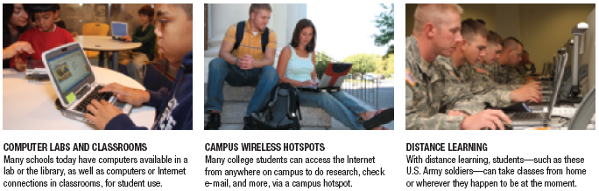
Computers in Education

Slide 19
Computers on the Job
Computers have become a universal on-the-job tool for decision-making, productivity, and communication
Used by all types of employees
Used for access control and other security measures
Use by service professionals is growing
Used extensively by the military
Employees in all lines of work need to continually refresh their computer skills

Slide 20
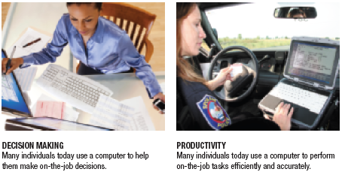
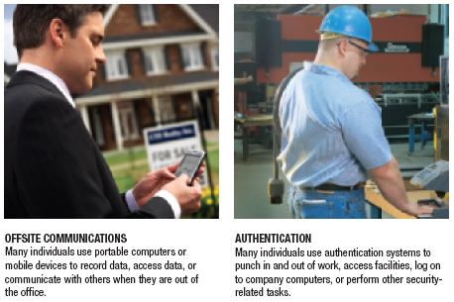
Computers on the Job

Slide 21
Computers on the Go
Computers are encountered in nearly every aspect of daily life
Consumer kiosks
ATM transactions
POS systems at retail stores
Self-checkout systems
Portable computers or mobile devices
M-commerce systems
GPS systems

Slide 22
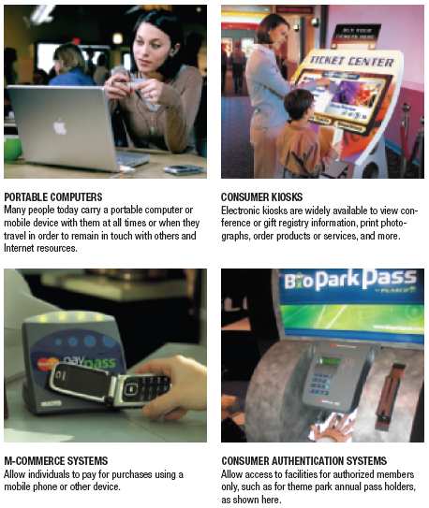
Computers on the Go

Slide 23
What Is a Computer and What Does It Do?
Computer: A programmable, electronic device that accepts data, performs operations on that data, and stores the data or results as needed
Computers follow instructions, called programs, which determine the tasks the computer will perform
Basic operations
Input: Entering data into the computer
Processing: Performing operations on the data
Output: Presenting the results
Storage: Saving data, programs, or output for future use
Communications: Sending or receiving data

Slide 24
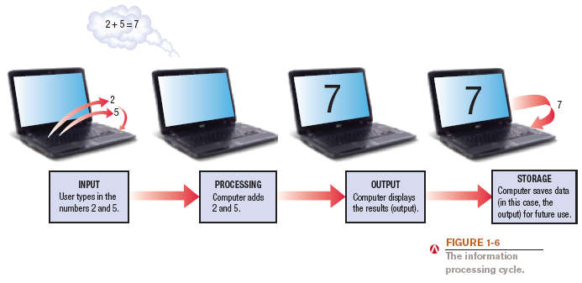
What Is a Computer and What Does It Do?

Slide 25
Data vs. Information
Data
Raw, unorganized facts
Can be in the form of text, graphics, audio, or video
Information
Data that has been processed into a meaningful form
Information processing
Converting data into information

Slide 26
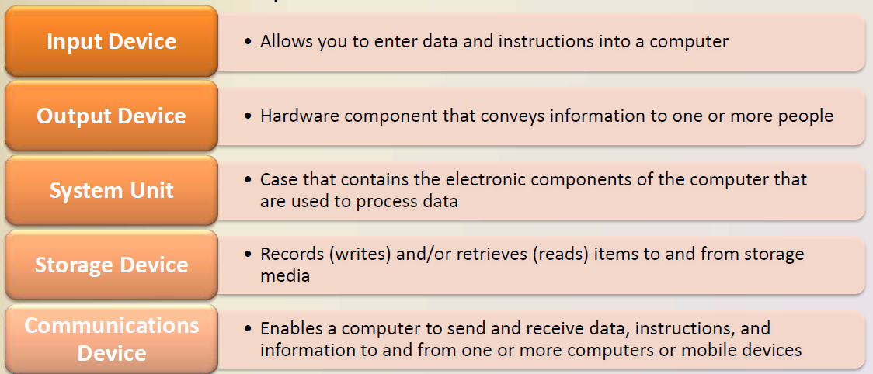
The Components of Computer
A computer contains many electric, electronic, and mechanical components known as hardware.

Slide 27
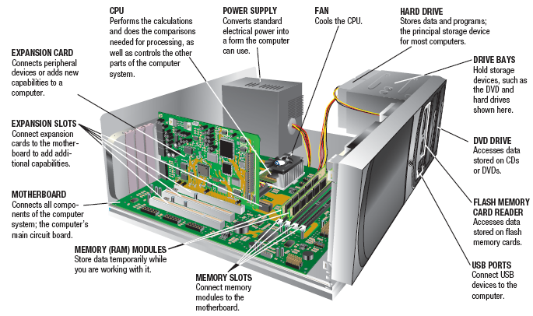
System Unit

Slide 28
Thank you!
Any Questions???

